Slide 1
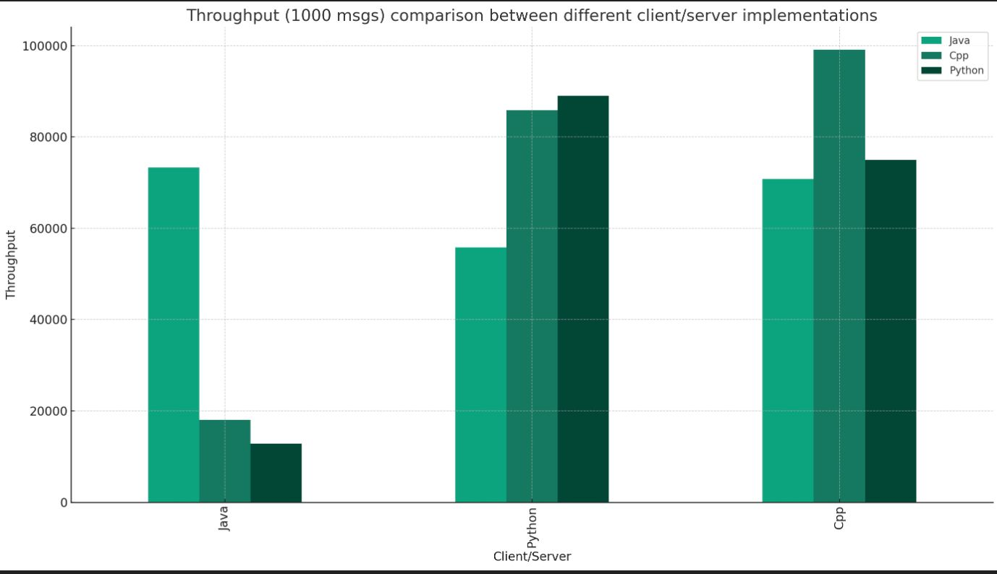
275 Mini Project-1 :Tri-code Communication
Challenges and Insights:
Implemented error handling for server shutdown scenarios to ensure proper client termination with retry strategy.
Resolved the close_wait state issue in clients to maintain system stability.(Bytes read -1)
Established thorough cleanup procedures for both server and client shutdowns to prevent resource leaks upon shutdown.(socket.close(), clt.stop() during error handling)
Cross-Language Communication: Developed a standardized
message format to facilitate seamless interlanguage communication between C++, Java, and Python components.
Team:
Sri Charan Reddy Mallu
Mahek Virani
Naga Varun Bathina

